Slide 1
Codes Steering Group Report ARMA Board of Directors November 2, 2017
Washington, DC
Aaron R. Phillips, TAMKO Building Products, Inc.
Michael Fischer, Vice President of Codes and Regulatory Compliance
Tim McQuillen, Director of Technical Services
Jim Hilyard, ARMA Consultant
Ally Peck, Staff Associate

Slide 2
Organization of Presentation
FOUNDATION
Mission and Structure
STAKEHOLDER RELATIONS
CODE DEVELOPMENT
ADVOCACY ISSUES
Wind Resistance
Reflectivity
Ventilation
Sustainability and Resilience
Aggregate Surfacing
Fire Resistance
TECHNICAL RESOURCE GROUP PROJECTS

Slide 3
FOUNDATION

Slide 4
Codes Steering Group Mission
Be a responsible and proactive advocate in the advancement and development of ARMA positions in the standards and regulatory arena.

Slide 5
Codes Steering Group Structure
Codes Steering Group
Chair: Aaron R. Phillips, TAMKO Building Products, Inc.
Staff Liaison: Mike Fischer, ARMA Vice President
of Codes & Regulatory Compliance
ARMA Cool Roof Task Force
Chair: Marty Ward, GAF
Staff Liaison:
Tim McQuillen, ARMA Director of Technical Services
ARMA Ventilation
Task Force
Chair: Paul Scelsi, Air Vent
Staff Liaison:
Tim McQuillen, ARMA Director of Technical Services
ARMA Technical Resource Group
Chair: Marcin Pazera, Owens Corning
Staff Liaison:
Tim McQuillen, ARMA Director of Technical Services
Notes:
CSG will continue to handle code advocacy for VTF, but other activities (communication, publications, etc.) will fall under the Technical Affairs Committee.

Slide 6
STAKEHOLDER RELATIONS

Slide 7
Insurance Institute for Business and Home Safety
IBHS Provides Update to ARMA Members
Heather Estes, IBHS, reviewed IBHS research programs for ARMA during the Summer Committee Meeting webinar series.
Current Wind Resistance Research Initiatives
Exploring alternate conditioning methods (e.g. radiant heat) for wind tests.
Evaluating effect of installation season, orientation, and pitch on wind resistance.
2018 Plans for Wind Resistance
Work with test labs to improve test procedures for D7158 and D3161.
Presentation at IRE on asphalt shingle installation for wind resistance.
Conduct D3161 tests on four-year-aged shingle panels from South Carolina exposure site.

Slide 8
Insurance Institute for Business and Home Safety
IBHS Provides Update to ARMA Members (continued)
Current Hail Research Initiatives
Compare impact resistance of aged and control shingles.
Develop a draft test protocol for impact resistance by end of 2017.
Design a single-line hail manufacturing machine for use by test labs.
2018 Plans for Hail Resistance
Expand field research to understand characteristics of small hail stones.
Develop definition of polymer-modified shingles.
Outdoor Aging
IBHS has more than sixty shingle roof decks on exposure, spread among several U.S. locations.

Slide 9
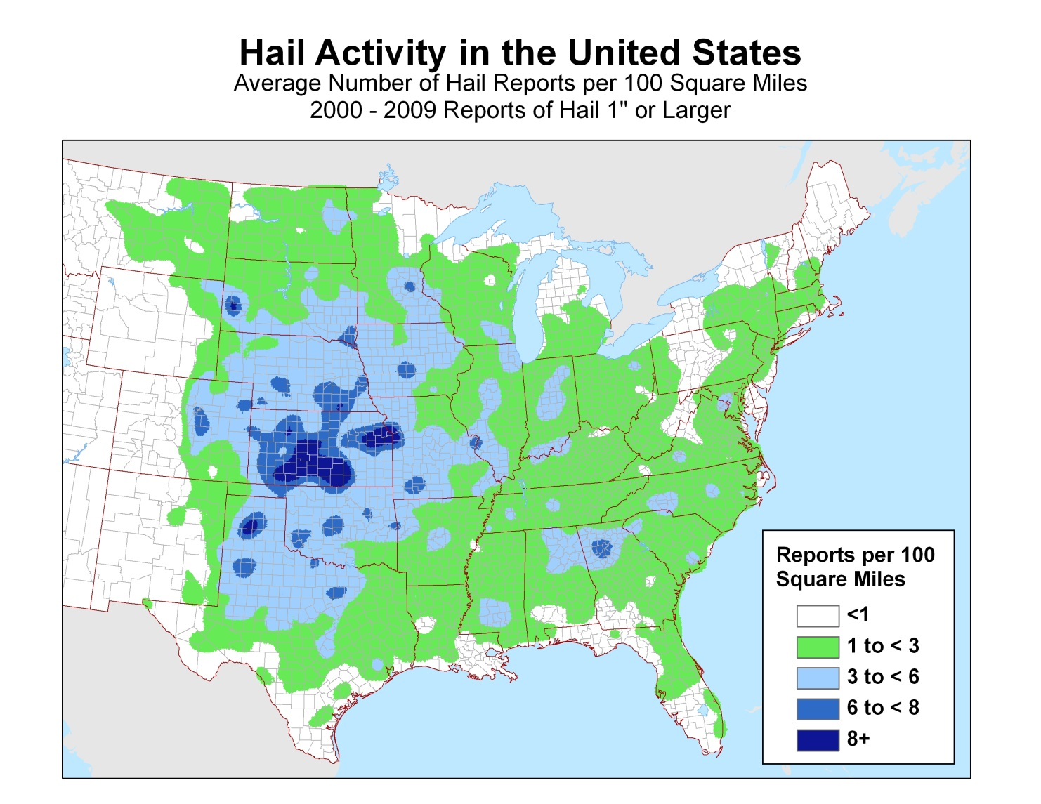
Insurance Institute for Business and Home Safety
Hail Storm Frequency Analysis Provides Perspective
Severe Weather Database files from the NOAA Storm Prediction Center provide the basis for a hail storm frequency map using data from 2000-2009 for reports of 1” or larger hail.
Map provided by Insurance Institute
for Business & Home Safety

Slide 10
Insurance Institute for Business and Home Safety
FORTIFIED Home™ Program
“IBHS created the FORTIFIED Home™ program to help strengthen homes from hurricanes, high winds, hail, and severe thunderstorms. Protect your home from natural disasters by using FORTIFIED Home construction standards and methods.”
Current Program Scope
New Construction
Existing Homes/Reroofing
Risks
Hurricane
High Winds
Hail
“Low-level Tornados”
Notes:
IBHS has added low-level tornados to this document.

Slide 11
Insurance Institute for Business and Home Safety
FORTIFIED Home™ Program
FORTIFIED Resources
Homeowner Brochures
Fact Sheets and Postcards
Other Resources
Standards & Technical Bulletins
ARMA TRG is working with IBHS on a review of the FORTIFIED Roofing
Standards and Technical Bulletins.

Slide 12
National Roofing Contractors Association
Co-Collaboration with IBHS and NRCA Continues
Staff representatives of NRCA, IBHS, and ARMA met in Chicago July 19th for forward planning on codes collaboration.
The group is scheduled to meet again later this year.
Additional staff-level meetings will take place in preparation for the 2021 ICC code development cycle.
Notes:
Mike to give me content for three slides.

Slide 13
Florida Roofing, Sheet Metal and Air Conditioning Contractors Association
FRSA Experiences Staff Change
Mark Zehnal, former FRSA Technical Director, left FRSA in 2016; he was ARMA’s primary point of contact with FRSA.
FRSA hired a new Director of Technical Services, but he left after a short stint. The position was recently filled by Mike Silvers, a long-time FRSA member.
Building code collaboration is important, especially in light of changes in the Florida code development process.
Notes:
Mike Silvers has accepted the new position [don’t tell this until it is announced]

Slide 14
ICC Building Officials
ARMA to Undertake Building Official Training
Kellen Company has been set up as an ICC preferred training provider.
Plan to create three courses: (1) residential roofing; (2) commercial roofing; and (3) existing building.
Each module will be prepared by staff and vetted by ARMA committees prior to becoming available.
Becoming an ICC Preferred Training Provider will create opportunity for ARMA to educate building officials on relevant asphalt roofing topics.
Training will provide a unique opportunity to interface with code officials and will build ARMA’s recognition and credibility with a key stakeholder group.
Notes:
Mike to edit this slide and update.
OGCV process makes this even more important.

Slide 15
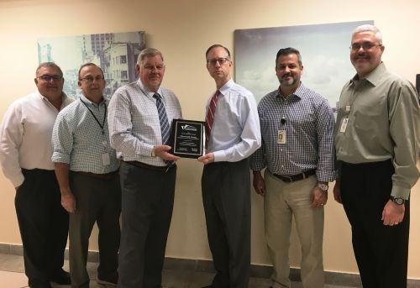
Miami-Dade County
Plan to Continue Cooperative Effort with Miami-Dade
Regulatory and Economic Resources Department
ARMA Public Partnership Award presented in April 13, 2017 to Michael Goolsby, Miami-Dade Board and Code Administration Division Director; certificates presented to participating staff members.
ARMA Press Release issued.
Technical Resource Group team will carry
the project forward to identify additional
opportunities for improvements in the
HVHZ codes and process.

Slide 16
National Association of Home Builders
Continued Collaboration on Model Codes
ARMA and NAHB have a history of working together on code advocacy.
Future areas of collaboration are likely to include structural requirements such as ASCE-7 updates, ventilated attics, impact resistance, and product application.

Slide 17
RICOWI
Mini-Deployment Investigates Hurricane Irma Damage
Two four-person teams were deployed to Naples and the Florida Keys to review and document damage from Hurricane Irma.
Investigation is scheduled October 31 to November 1.
Expect preliminary update on South Florida field investigations at RICOWI meeting this week.
Notes:
Mention that there will be an update on RICOWI Best Practices project in Technical Affairs report.
Other organizations are investigating building damage from Irma.
Mike agreed to make sure RICOWI will communicate their results to Florida Building Commission.
BOAF, U of F, FEMA, and others are making assessments.
Unofficial message is that governor of Florida ordered 100,000 blue tarps, but they are not being used.

Slide 18
CODE DEVELOPMENT

Slide 19
ICC Model Building Codes
Development of 2021 ICC Model Codes has Started
2018 ICC codes are available for adoption.
ICC Board of Directors approved revisions to procedural rules for code development hearings (i.e. CP-28) on September 9th; Fischer contributed suggestions and participated in development of adopted changes.
New standards to be available in a draft form by the Committee Action Hearing and are to be finalized prior to the Public Comment Hearing.
Administrative Committee will no longer hear standards updates that involve technical changes to the standards. Reference standards with any correlating changes will not be heard by the ADMIN committee but by the responsible technical committee.
Group A development will take place in 2018; codes of interest to ARMA include IBC (General and Fire Safety provisions), IFC, and IWUIC.
Notes:
ARMA may submit ventilation proposal for Vapor Diffusion Ports
Anticipate ARMA activity in Group A to be primarily defensive in nature, i.e. responding to proposals advanced by other parties.
Change in procedures were brought about in strong part by outcry over how adoption of ASCE 7-16 was handled.

Slide 20
ICC Model Building Codes
Code Development Schedule for Group A
Code Change Submittal Deadline 1/8/2018
Proposed Changes Available for Review 2/28/2018
Committee Action Hearings (CAH) 4/15-29/2018
CAH Results Published 5/30/2018
Public Comment Submittal Deadline 7/16/2018
Public Comment Hearings 10/24-31/2018
Online Governmental Consensus Voting ~ 11/15/2018

Slide 21
Florida Building Codes
Effective Date of 6th Edition (2017) Appears Firm
Officials have maintained 12/31/2017 as the effective date for implementation of the 6th Edition Florida codes.
Future Florida Building Codes Disconnect from ICC Codes
HB 1021 was signed into law by Governor Rick Scott on June 23rd with an effective date of July 1, 2017. The bill amended the portion of Florida Statutes (553.73) related to the Florida Building Code.
The Florida Building Commission approved procedures for development of the next Florida Building Codes at their most recent meeting.
Every change made at ICC will require resubmission and approval
in the new Florida Building Code development process.
Notes:
As of 10/6, no need for a glitch cycle. Very unlikely there will be a glitch cycle. They will begin adoption process for 2018 I-codes next year.

Slide 22
Florida Building Codes
Specific Changes Implemented by HB 1021
ICC codes are no longer used as the sole foundation for Florida codes.
Review of most-recent updates to ICC codes is required, but adoption into the Florida codes will require action (i.e. not done by default). Adoption of ICC code updates is “only as needed to accommodate the specific needs of this state.”
Required to adopt updates to ICC codes necessary to maintain eligibility for federal funding and discounts from the National Flood Insurance Program, Federal Emergency Management Agency, and the U.S. Department of Housing and Urban Development.
Three-year code update cycle is maintained.
Notes:
Other changes to required voting majorities and size/makeup of the commission did not become part of the new statute.
Under the former process, if we got a change done in ICC it generally flowed into Florida codes without difficulty. Under the new system, we will have to sell all the changes in Florida.

Slide 23
Florida Building Codes
HB 299 Alters Size and Composition of Commission
Proposal to reduce Florida Building Commission size and composition was not included in the final version of HB 1021, but that concept has reemerged this session in HB 299.
Original bill . . .
Reduces commission size from 27 to 11 members.
Eliminates the seat allocated to the building products manufacturing industry.
An amendment . . .
Reduces commission size from 27 to 15 members.
Retains the seat allocated to the building products manufacturing industry.
ARMA will track this bill.
Notes:
Other changes to required voting majorities and size/makeup of the commission did not become part of the new statute.
Under the former process, if we got a change done in ICC it generally flowed into Florida codes without difficulty. Under the new system, we will have to sell all the changes in Florida.

Slide 24
ADVOCACY ISSUES

Slide 25
Wind Resistance
RELEVANCE FOR ARMA
Various stakeholders are investigating building envelope wind resistance, raising questions about existing requirements and test methods, and proposing changes.
ACTIVE ADVOCACY AND MONITORING
Local Code Amendments
Standards Development
INVOLVED ARMA RESOURCES
Codes Steering Group

Slide 26
Wind Resistance
Monroe County, FL May Restrict Asphalt Shingles
ARMA staff and members are tracking an issue in Monroe County, Florida (the Keys and Everglades) related to acceptance of asphalt shingles.
Perceptions about asphalt shingle performance during Hurricane Irma has led county officials to consider two options:
Request Citizens Property Insurance Corporation cover costs to replace asphalt shingle roofs with tile or metal when processing future claims.
Promulgate a code change to preclude the use of asphalt shingles.
ARMA staff have engaged with the County Commission and will meet with Citizens before Nov. 14th County Commission meeting in Key West.
ARMA’s goal is to encourage enforcement of current proven
building standards for wind resistance of all roofing systems,
including installation inspection.

Slide 27
Wind Resistance
ICC-600 Revision in Process
The ICC Standard for Residential Construction in High-Wind Regions is being updated.
Suggested revisions from the public are due December 11th.
ARMA may submit proposed revisions to align sections of the standard with underlayment requirements ARMA advocates in the building code.
Notes:
Recognize Type III D4869 in addition to Type IV.

Slide 28
Reflectivity
RELEVANCE FOR ARMA
Energy efficient building designs often focus on roof reflectivity.
ACTIVE ADVOCACY AND MONITORING
California Building and Energy Codes
Local Code Amendment
Stakeholder Programs
INVOLVED ARMA RESOURCES
Codes Steering Group
Cool Roof Task Force
Notes:
ARMA is working to ensure consistency between RESNET 301 and code requirements for the applicable standards for roofing reflectance.

Slide 29
Reflectivity
California 2019 Building Energy Efficiency Standards
California Energy Commission (CEC) continues to assert there will be no changes to the reflective roof requirements.
Effective date of 2019 Building Energy Efficiency Standards (Title 24, Part 6) is projected as January 1, 2020.
CEC hearing for 45-Day Language is tentatively scheduled for January 11, 2018.
Climate Resolve is advocating the CEC increase reflective roof requirements to Energy Star levels (i.e. from current 0.20 solar reflectance to 0.25).

Slide 30
Reflectivity
Los Angeles County Green Building Standards Code
LA County is working toward a future revision of their cool roof requirements to stipulate stricter reflectivity requirements than those in place statewide by modifying the 2017 County of Los Angeles Green Building Standards Code.
Proposal requires roofs on most new buildings and substantial remodels to meet reflectivity as follows:
Slope ≤ 2:12 0.65
Slope > 2:12 0.23
A copy of the draft ordinance was made available October 26th. The comment deadline is November 6th. ARMA is preparing a response.
Stakeholder webinar is tentative for November 9th. Public Hearings are tentatively set for November 28th, December 19th,
and January 30th.
Notes:
These are the Tier 2 requirements of CalGreen, which are voluntary rather than mandatory.

Slide 31
Reflectivity
Cool Roof Rating Council
Retesting Working Group continues their work to develop a process to determine when retesting is required in response to changes in reflectivity and emissivity test methods.
Considering research projects, including evaluation of reflectivity and emissivity beyond three years.
Notes:
Mike to take CEC over to RESNET slides.

Slide 32
Ventilation of Steep-slope Roof Attics
RELEVANCE FOR ARMA
Design concepts for vented and unvented attics are evolving, driven primarily by increasing concerns about building energy efficiency and moisture management.
ACTIVE ADVOCACY AND MONITORING
ICC Model Code Development
Research Projects
INVOLVED ARMA RESOURCES
Ventilation Task Force
Codes Steering Group

Slide 33
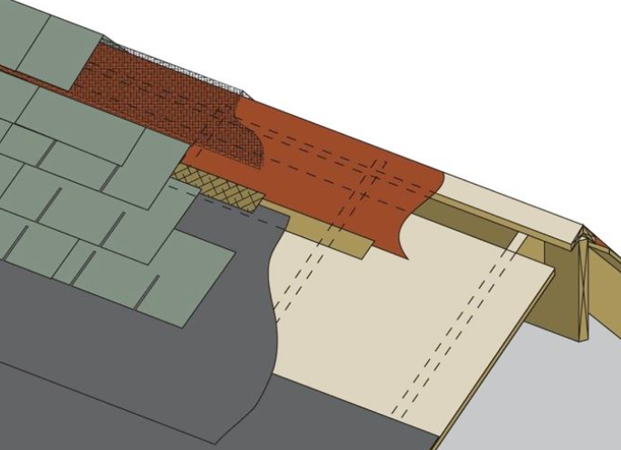
Ventilation of Steep-slope Roof Attics
Developing Strategy on Vapor Diffusion Ports
The CSG is working with the Ventilation Task Force to develop an appropriate strategy to improve code language associated with vapor diffusion ports in the 2021 ICC code development cycle.
Notes:
Mike to fill in info here.

Slide 34
Ventilation of Steep-slope Roof Attics
Florida Building Commission Sealed Attic Research
Investigating potential for moisture accumulation in roof sheathing of unvented attics with spray polyurethane foam insulation beneath roof sheathing.
Four Florida homes have been instrumented to monitor hygrothermal and thermal performance of the sealed attic.
Roofing Technical Advisory Committee (TAC) reviewed and accepted the final draft for this research project at their June 26th meeting.
Report concluded that existing code provisions provide adequate protection against moisture affecting the durability of roof sheathing.
Notes:
TBD whether this project will continue in future years. Selection of research projects will take place next year.
Dr. Bill Miller, ORNL
Dr. David Prevatt, U of F

Slide 35
Sustainability and Resilience
RELEVANCE FOR ARMA
Sustainable and resilient construction are rapidly emerging influences in the building materials industry.
ACTIVE ADVOCACY AND MONITORING
Legislative Initiatives
Standards Development
INVOLVED ARMA RESOURCES
Codes Steering Group

Slide 36
Sustainability and Resilience
Denver Green Roof Initiative
Referendum on Denver ballot this November to require green roofs on most new structures with roofs of at least 25,000 square feet.
Area of roof required to be vegetative ranges from 20% to 60% depending on type of structure and total square footage.
Residential buildings of four stories or less are exempt.
Applies to existing buildings that meet the size thresholds when roof replacement occurs and when additions to existing buildings cause them to meet the size threshold.
ARMA is monitoring but not directly involved.

Slide 37
Sustainability and Resilience
National Green Building Standard (NGBS) Being Updated
ICC/ASHRAE 700 (NGBS) is a residential green building standard primarily focused on one and two family homes.
Development of the 2018 version is in progress with approval and publication targeted in 2018.
ARMA staff is participating in the update of this standard.
The proposed scope increase to include other residential occupancies (assisted living facilities, residential board and care facilities, and group homes) creates an overlap with ASHRAE 189.1.
Notes:
Standard has been delayed but trying to complete this year.
A proposed scope increase has taken place.

Slide 38
Aggregate Surfacing Restrictions
RELEVANCE FOR ARMA
In the International Building Code (IBC), aggregate used as surfacing for roof covers and aggregate, gravel or stone used as ballast is prohibited on buildings in hurricane-prone regions and is height limited in areas outside the hurricane-prone regions.
ACTIVE ADVOCACY
ICC Model Code
Florida Code Adoption
INVOLVED ARMA RESOURCES
Codes Steering Group
Height Limitations
Banned
Figure 1509.3(1). Excerpted from the 2015 International Building Code;
Copyright 2014. Washington, D.C.: International Code Council.
Reproduced with permission.
All rights reserved. www.iccsafe.org

Slide 39
Aggregate Surfacing Restrictions
ARMA to Continue Efforts to Reverse Aggregate Ban
ARMA will work with key stakeholders (IBHS, SPRI, NRCA) to develop new code language for the 2021 ICC code development cycle.

Slide 40
Fire Resistance
RELEVANCE FOR ARMA
Roofing systems are required by building codes to provide fire resistance for the roof portion of the building envelope.
ACTIVE ADVOCACY AND MONITORING
Stakeholder Programs
INVOLVED ARMA RESOURCES
Codes Steering Group

Slide 41
Fire Resistance
Suburban Exterior Fire Work Group
Exterior cladding interests, National Association of Home Builders, Maryland Building Officials, and other parties are developing code proposals to mitigate building fires that progress up walls and penetrate attic through soffit vents.
Draft proposals include:
Prohibit flammable mulch along walls.
Restrict smoking near structures.
Create requirements for soffit vents to resist penetration of fire from wall.
Planning test program to evaluate soffit vent fire resistance.
A recommendation whether to participate will be forthcoming.
Notes:
Estimated cost to participate in the test program is $5-10,000.

Slide 42
Technical Resource Group Projects
Marcin Pazera, Owens Corning
Michael Fischer, Vice President of Codes and Regulatory Compliance
Tim McQuillen, Director of Technical Services
Jim Hilyard, ARMA Consultant
Ally Peck, Staff Associate

Slide 43
IBHS FORTIFIED Home™ Document Review
Five Technical Bulletins and Two Standards Under Review
IBHS requested ARMA review IBHS FORTIFIED Home™ roofing-related documents for conflict with building codes, ARMA documents, and manufacturer installation instructions.
All five Technical Bulletins have been reviewed by the TRG team and CSG members.
TRG review of the High-Wind Standard is in progress.

Slide 44
ASTM D7158 Height Limit Clarification
Effort to Clarify Height Limitation Question Continues
Do the classifications determined by ASTM D 7158 apply to buildings 60 feet or less, or is the height limitation 33 feet?
Dr. Pertka provided a letter June 10, 2017 stating that D7158 Class H shingles are appropriate for use on buildings up to 60 feet in height.
Further clarification is being sought but has not been obtained due to unavailability of Dr. Peterka.

Slide 45
Texas Department of Insurance
ARMA forms Technical Resource Group for TDI
ARMA staff, members, and Texas Department of Insurance (TDI) representatives met May 16th to discuss member concerns with TDI’s product approval process.
ARMA formed a Technical Resource Group to develop options to address member concerns about timeliness; the team held its first teleconference
October 27th.
ARMA staff will develop a document TDI can use to educate inspectors about asphalt shingle code compliance to serve as a replacement for the “asphalt shingle list.”

Slide 46
Questions or comments?

Slide 47
Requested Actions
Acceptance of Codes Steering Group report as presented.

